Slide 1

Similar Products Recommender
Group 08
Casey, Mei Xin, Jing Ying, Rachael, Tanya
Notes:
Intro+Motivation+Dataset understanding - Casey
EDA+Preprocess - JY
Cosine Similarity - Rach
NN (Pipeline) - Tanya
NN Parameters +Conclusion - MX

Slide 2
Outline
MOTIVATION
DATASET UNDERSTANDING
EXPLORATORY DATA ANALYSIS
MODELLING
RESULTS
FUTURE IMPROVEMENTS
Why did we choose to embark on this project?
A look at our dataset
Exploring and preparing our data
1. Cosine similarity
2. Neural network
3. Recommender
Analysing our model’s performance
What could we have done better?

Slide 3
Motivation

Slide 4


Objectives
FOR THE COMPANY
FOR CUSTOMERS
Customer leaves review
↓
Predict review score
⇓
Determine areas of customer satisfaction/dissatisfaction
Improve services
Input item of interest
↓
Recommend similar items
⇓
Increase sales
Build customer loyalty

Slide 5
Dataset Understanding

Slide 6
Amazon Fine Foods
Product ID | Rating Score | Helpfulness Score | Review Text
B00813GRG4 | 1 | 0 | The peanuts are lousy. Small and salty...
B000EOXQS0 | 5 | 2 | The soup tastes like heaven!!

Slide 7
Exploratory Data Analysis

Slide 8
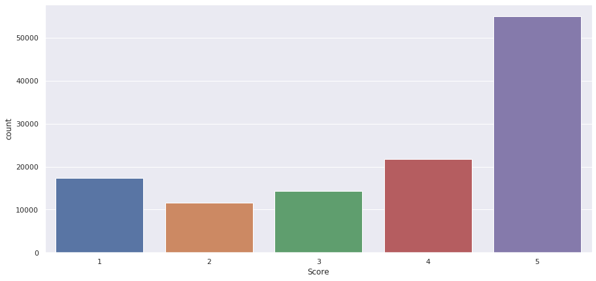
Rating Score Distribution
Notes:
Moving on to exploratory data analysis. To explore our data, we first looked at the distribution of rating scores across all products to gauge how well-perceived they are on average. From this plot, we can observe that most Amazon fine food products received a rating of 5, meaning majority of customers were satisfied with the products they bought.

Slide 9
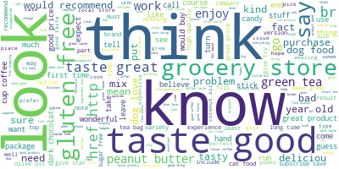
Word Cloud
Notes:
Next, we generated a word cloud for all reviews left by customers. This gives us an overall picture of common words included in reviews. From the word cloud, we can see that most frequently used words include ‘taste’, ‘good’ or ‘look’. However, we also noticed that certain irrelevant words have been taken into account, such as ‘href’, ‘http’ or ‘br’. Hence, we performed text preprocessing to only keep important words for better result accuracy and faster computation.

Slide 10
Preprocess
The peanuts are lousy. Small and salty!!!
Remove symbols
Convert to lowercase
Remove short words
Remove stop words
Lemmatization
peanuts lousy small salty
Notes:
We removed symbols like full-stops or exclamation marks as they are not meaningful and will only interfere with analyses.
We converted all uppercase letters to lowercase for consistency and ease of processing.
We removed words that are less than 3 characters in length as it is highly unlikely that such short words are significant.
We also filtered out stop words, which are commonly occurring words like ‘the’, ‘are’ or ‘and’. By removing these low information words, we can focus on more important words instead.
Lastly, we performed lemmatization, which is the reduction of inflected words to their root forms. For example, ‘helps’, ‘helping’ and ‘helped’ will all be lemmatized to ‘help’. This is necessary to ensure that words with the same root form are not interpreted as different words. We chose lemmatization over stemming as it produces more accurate results. The reduction of words through lemmatization will always be an actual word in the dictionary and lemmatization is capable of identifying words of different forms but with the same basic meaning. Hence, even though lemmatization is slower, we still chose it over stemming, balancing between accuracy and speed.

Slide 11
Modelling

Slide 12
Model Outline
Cosine Similarity
1
Neural Network
2
3
Recommendation System
Notes:
For our model, we start of with cosine similarity to aggregate and calculate the similarity between products,
then we will go into how we train the neural network and the hyperparameters we have chosen.
Lastly, we will explain how we produce a recommendation and what are some of the use cases.

Slide 13
1. Cosine Similarity
Calculate the similarity between the product reviews

Slide 14
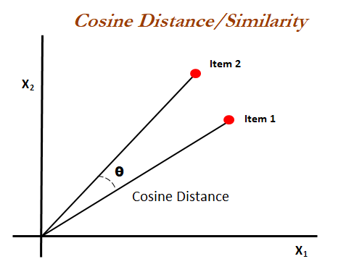



Objective
Notes:
Since this is a item-based recommendation system, we will be utilizing the product reviews to generate a feature vector in which we can conduct cosine similarity on

Slide 15
Overview
Step 1
Vectorise the input, aka the product reviews
Step 2
Calculate the average vector for all words in every sentence in the product reviews
Step 3
Conduct cosine similarity between vectors of reviews
Notes:
Objective: calculate the similarity between the aggregation of reviews between 2 products
Overview, 3 steps

Slide 16
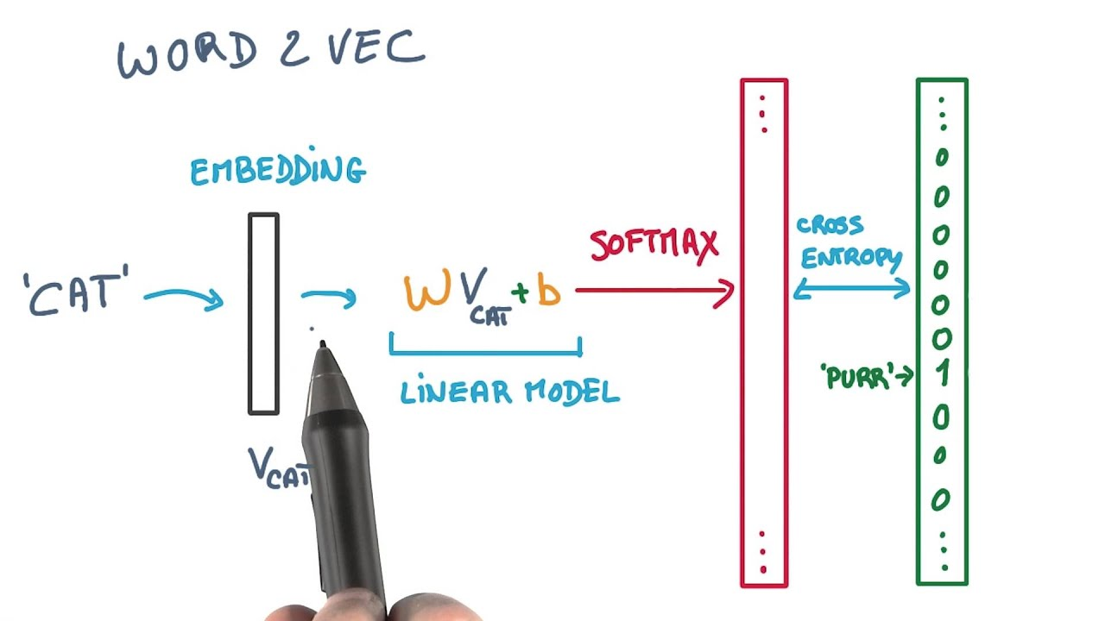
Step 1: Entities Embedding
Using Gensim model, Word2Vec, we convert the words into vectors
(trained with hierarchical softmax)
Step 1
Vectorise the input, aka the product reviews
Step 2
Calculate the average vector for all words in every sentence in the product reviews
Step 3
Conduct cosine similarity between vectors of reviews
Notes:
using word2vec we are able to vectorise the reviews

Slide 17
Step 2: Aggregation to generate Feature Vector
Step 1
Vectorise the input, aka the product reviews
Step 2
Calculate the average vector for all words in every sentence in the product reviews
Split the input sentences of each review by space
Sum the vector of each word (based on the Word2Vec embedding)
Divide by the total number of words
Step 3
Conduct cosine similarity between vectors of reviews

Slide 18
Step 3: Cosine Similarity between Feature Vector
Step 1
Vectorise the input, aka the product reviews
Step 2
Calculate the average vector for all words in every sentence in the product reviews
Using scipy’s spatial function, we can calculate the cosine distance between the feature vectors
To similarity for comparison: Similarity = 1 - Cosine Distance
Step 3
Conduct cosine similarity between vectors of reviews

Slide 19
2. Neural Network
Predict if the product should be recommended or not

Slide 20

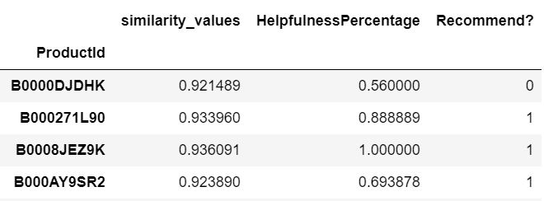
Step 1: Filter similar products
Threshold = mean + 2*sd
Step 2
Calculate the average vector for all words in every sentence in the product reviews
Milk
Tea
Milo
Horlicks
Notes:
using word2vec we are able to vectorise the reviews

Slide 21
Step 2: Split into training and test
Similarity Values
Recommend or not?
Hidden Layers
Helpfulness Scores

Slide 22
Step 3: Training Neural Network
Choice of hyperparameters
Number of hidden layers : 2
Activation functions
Hidden layers : ReLU
Output layer : Sigmoid
Optimizer : Adam
Loss Function : Binary Cross Entropy

Slide 23
3. Recommender

Slide 24
Overview
Phase 1
Product level Data Aggregation
Phase 2
Shortlisting all the products using cosine similarity
Phase 3
Determining recommended products using a Neural Network

Slide 25
Overview of the pipeline
Step 1
Product Reviews , Score , Helpfulness Parameters are aggregated at a Product level for all the products in the dataset
Step 3
Products are then shortlisted based on cut-off threshold for their similarities with the “search product”
Step 2
Cosine Similarity is run between the all the reviews of products in the dataset and the “search product”
Step 4
Similarity and helpfulness scores are input into Neural Network to determine if shortlisted product is recommended
Notes:
Aggregation of parameters on a product level -> Because we have multiple reviews for products
Shortlist products based cosine similarity between product reviews in the dataset and the search product
Determining which ones to recommend based on the product

Slide 26
Results

Slide 27
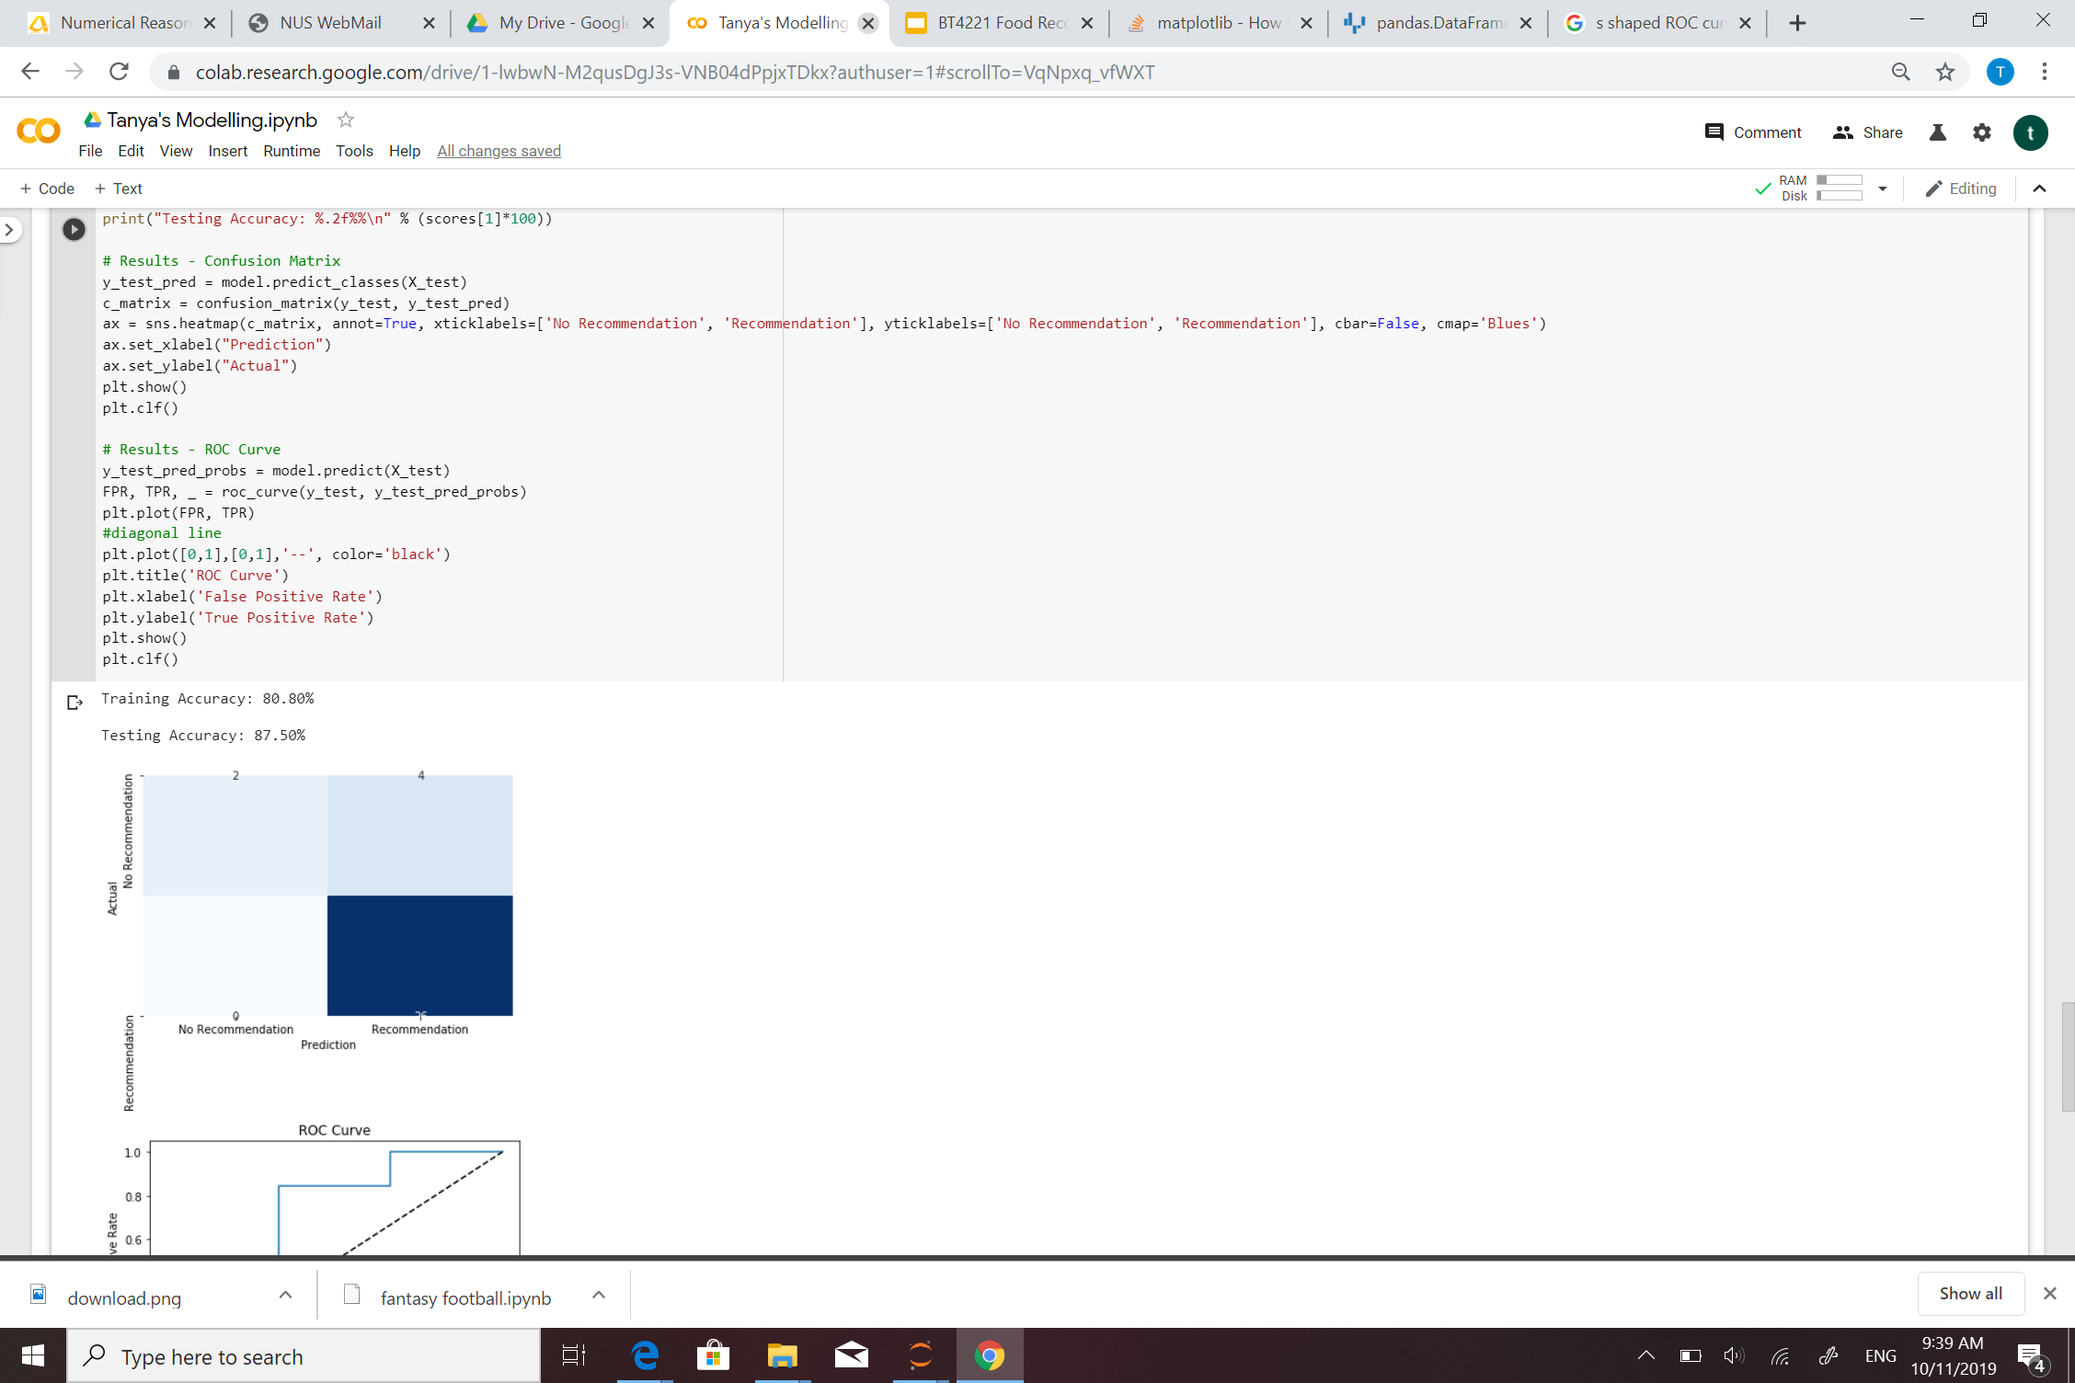
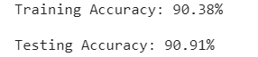
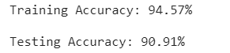
Results Analysis
Different Products —> Varying Accuracies
Most around 75-95%
Results may differ based on :
Structure of Neural Network
Nodes
Layers
Number of Inputs

Slide 28
Future Improvements

Slide 29
Potential Improvements
Include Product Name
Larger dataset
Other Data Sources
Other features (i.e Product Category)
Do recommendation based on timestamp
Reduce Overfitting
Include images for search

Slide 30
Extended Use Cases

Slide 31
Extended Use Cases
Suicide Prevention
Spam Mail
Proposal Screening
Medical diagnosis
Recommending products when there is no stock of a product

Slide 32
Product Reviews, Recommend?, Helpfulness Percentage are aggregated at a product level for all product in the dataset
Cosine similarity is run based on reviews of the searched product and all the other products
Products are shortlisted based on cut-off threshold for their similarities with the searched product
Similarity and helpfulness score added to the Neural Network to determined if shortlisted products should be recommended

Slide 33

Thank you!

